Slide 1

Growth Force

Slide 2

Goal:
Improve donor retention by deepening relationships and providing advanced analytical tools that leverage the power of technology.

Slide 3

You need to feel connected to the cause

Slide 4
“When I met Gabby for the first time at a check up appointment, I could have never imagined the impact she would have on my life, but five years and around a hundred memories later, having Gabby as my little sister continues to be something very special and important to me.”
Alexa, NYU about the B+ Heroes program
Notes:
Example of a donor, who started in college, feeling connected to B+ through the B+ Heroes program 5 years later

Slide 5

Defining the user to build better relationships
Figuring out the demographics of our users to better personalize their experiences with B+
Currently using Salesforce, but not to full capacity
Large social media following, regular blog posts, but no analytics for defining performance
Notes:
Current overview of problem we are trying to solve
Getting demographic data will teach us more about who to target

Slide 6
Our solution
Growth Force

Slide 7

Easier analytics for personalized marketing
Tells who to target
Compare to current users
Maximize donations long-term
Using Machine Learning, we target a user based on regions they are most likely to donate. Also, a feature identifying our most connected users.
Compare the data to Salesforce’s current data on B+.
Bridge the gap between the two data sets, targeting high potential users for eventual donations and more personalized connection with highly connected users.
Notes:
Our program shows potential markets that B+ could reach out to and target
Using Salesforce, B+ could compare this data to current users

Slide 8


Process
Process
Marked & Web Scraped
Raw Data
API Calls
Angular JS
Webpage
MySQL Database
ML Model
Machine Learning
Visualization
Structured
Data

Slide 9

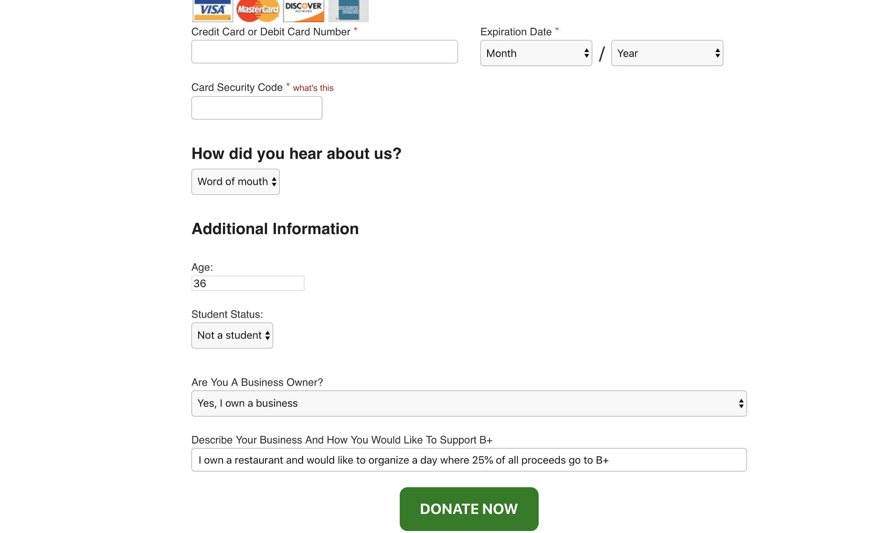
Chrome Extension
Notes:
Online resources are considered 20% more useful than direct mail when it comes to influencing donors.
57% of people who watch nonprofit videos go on to make a donation.

Slide 10
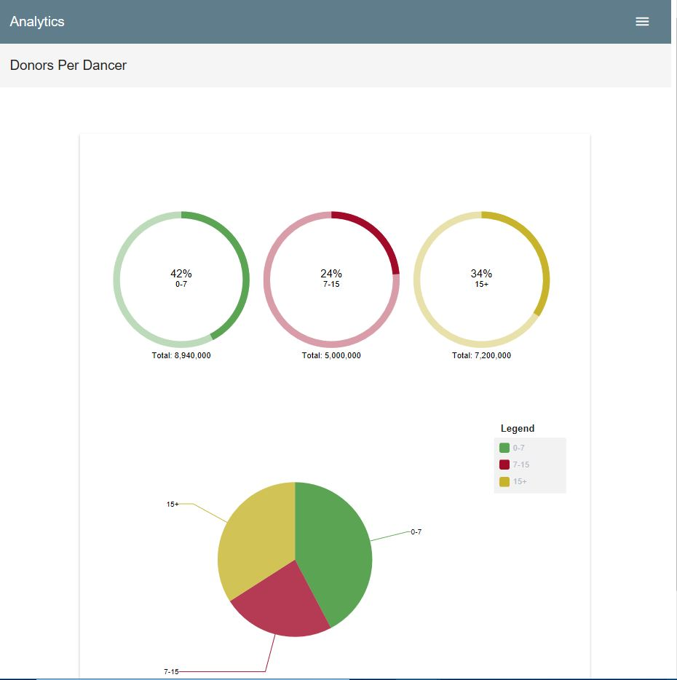
User Interface

Slide 11

THANK YOU!
Any questions?

